Slide 1








Hackathon Twitter-Heron Use Case CALM Coders
Chaitanya Sai Manne
Akhilesh Gattu
Latha Muddu
Manikanta Maddula

Slide 2
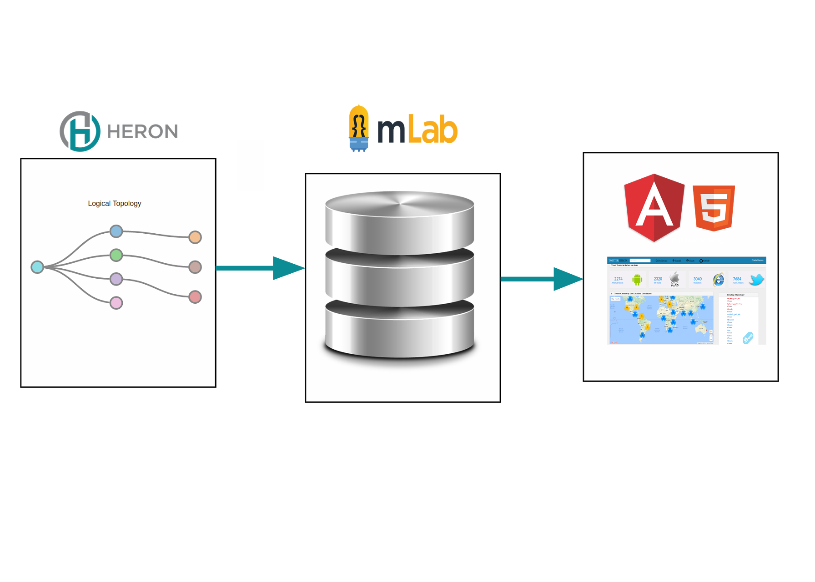
Architecture

Slide 3
Twitter - Heron
Real Time BI : Every tweet is generated from a particular source. Counting the number of tweets by grouping based on the source and counting the total number of tweets.
Real Time Trends : We identified the top ten hashtags based on number of tweets that has a particular hashtag and calculated their respective count.
Every tweet is done from a particular place. Latitude and Longitude will define it uniquely. Pointing these coordinates on the map and counting the number of tweets from one particular location and coloring it respectively.

Slide 4
Twitter - Heron
Additionally, we have also computed the top 3 countries tweeting for every two minutes.
Sentiment Analysis is also done on the tweets collected and a pi-chart is taken showing the positive, Negative or neutral tweets and their respective count.
All the information is store in MongoDB, retrieved it and displayed on the UI. All the data on the UI will be refreshed every second.

Slide 5
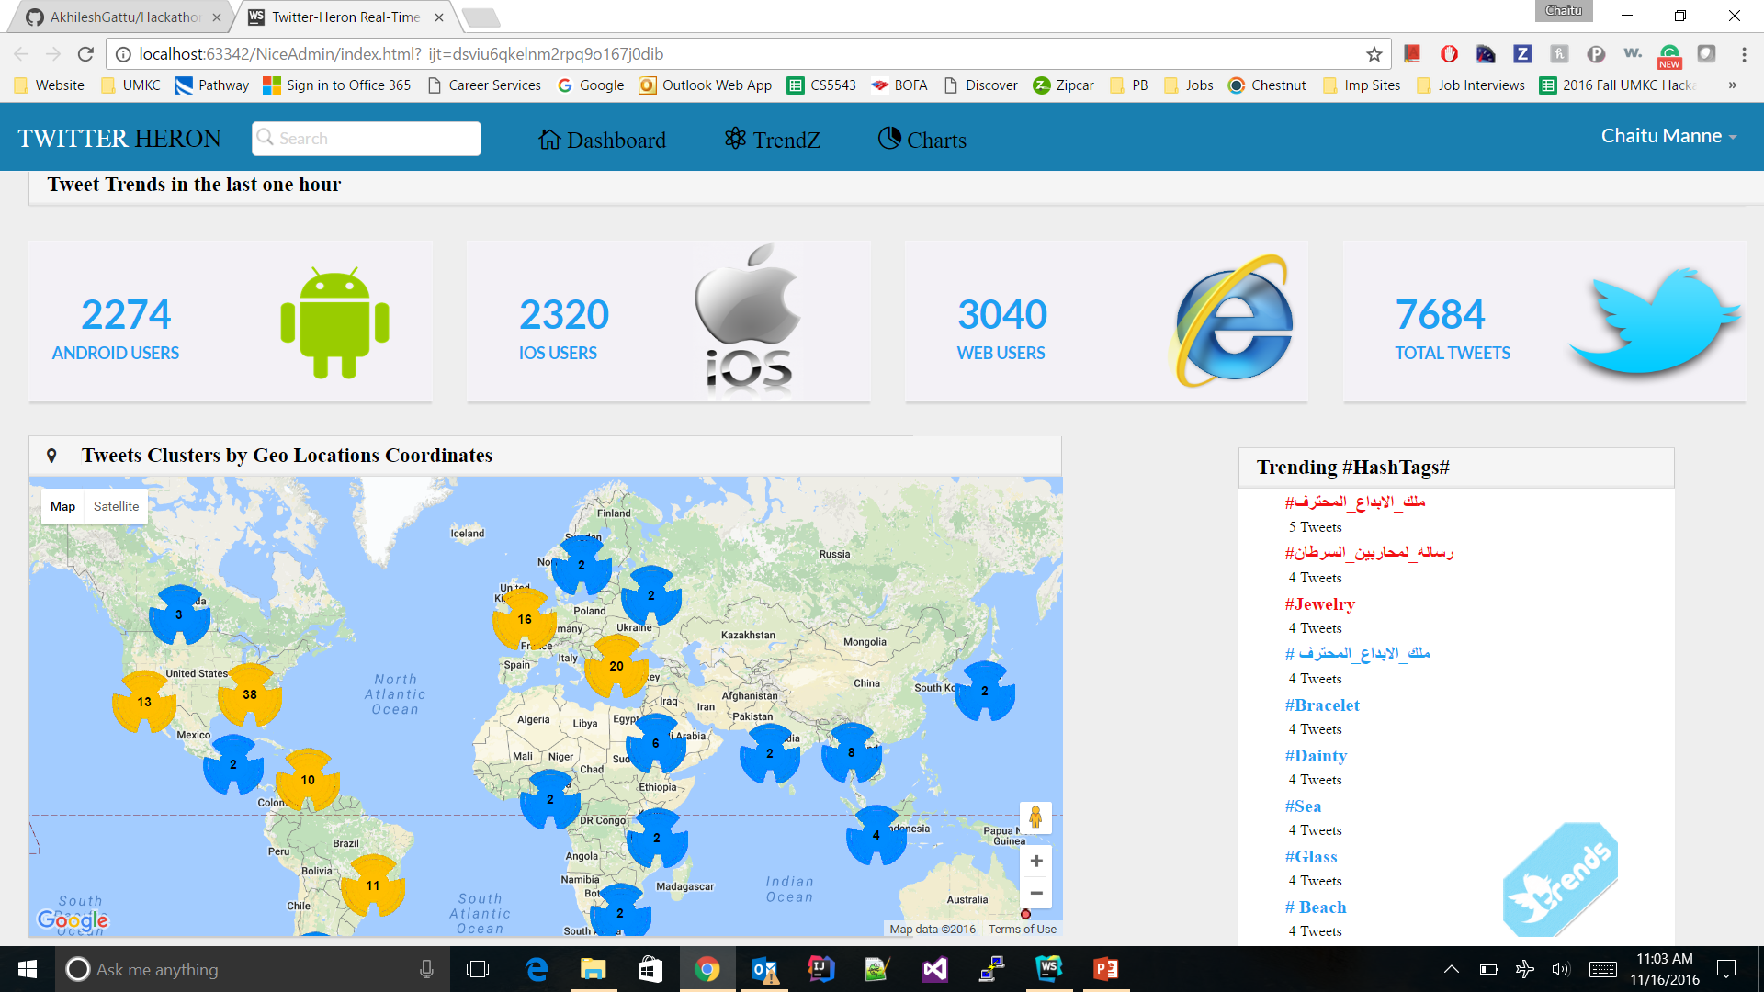
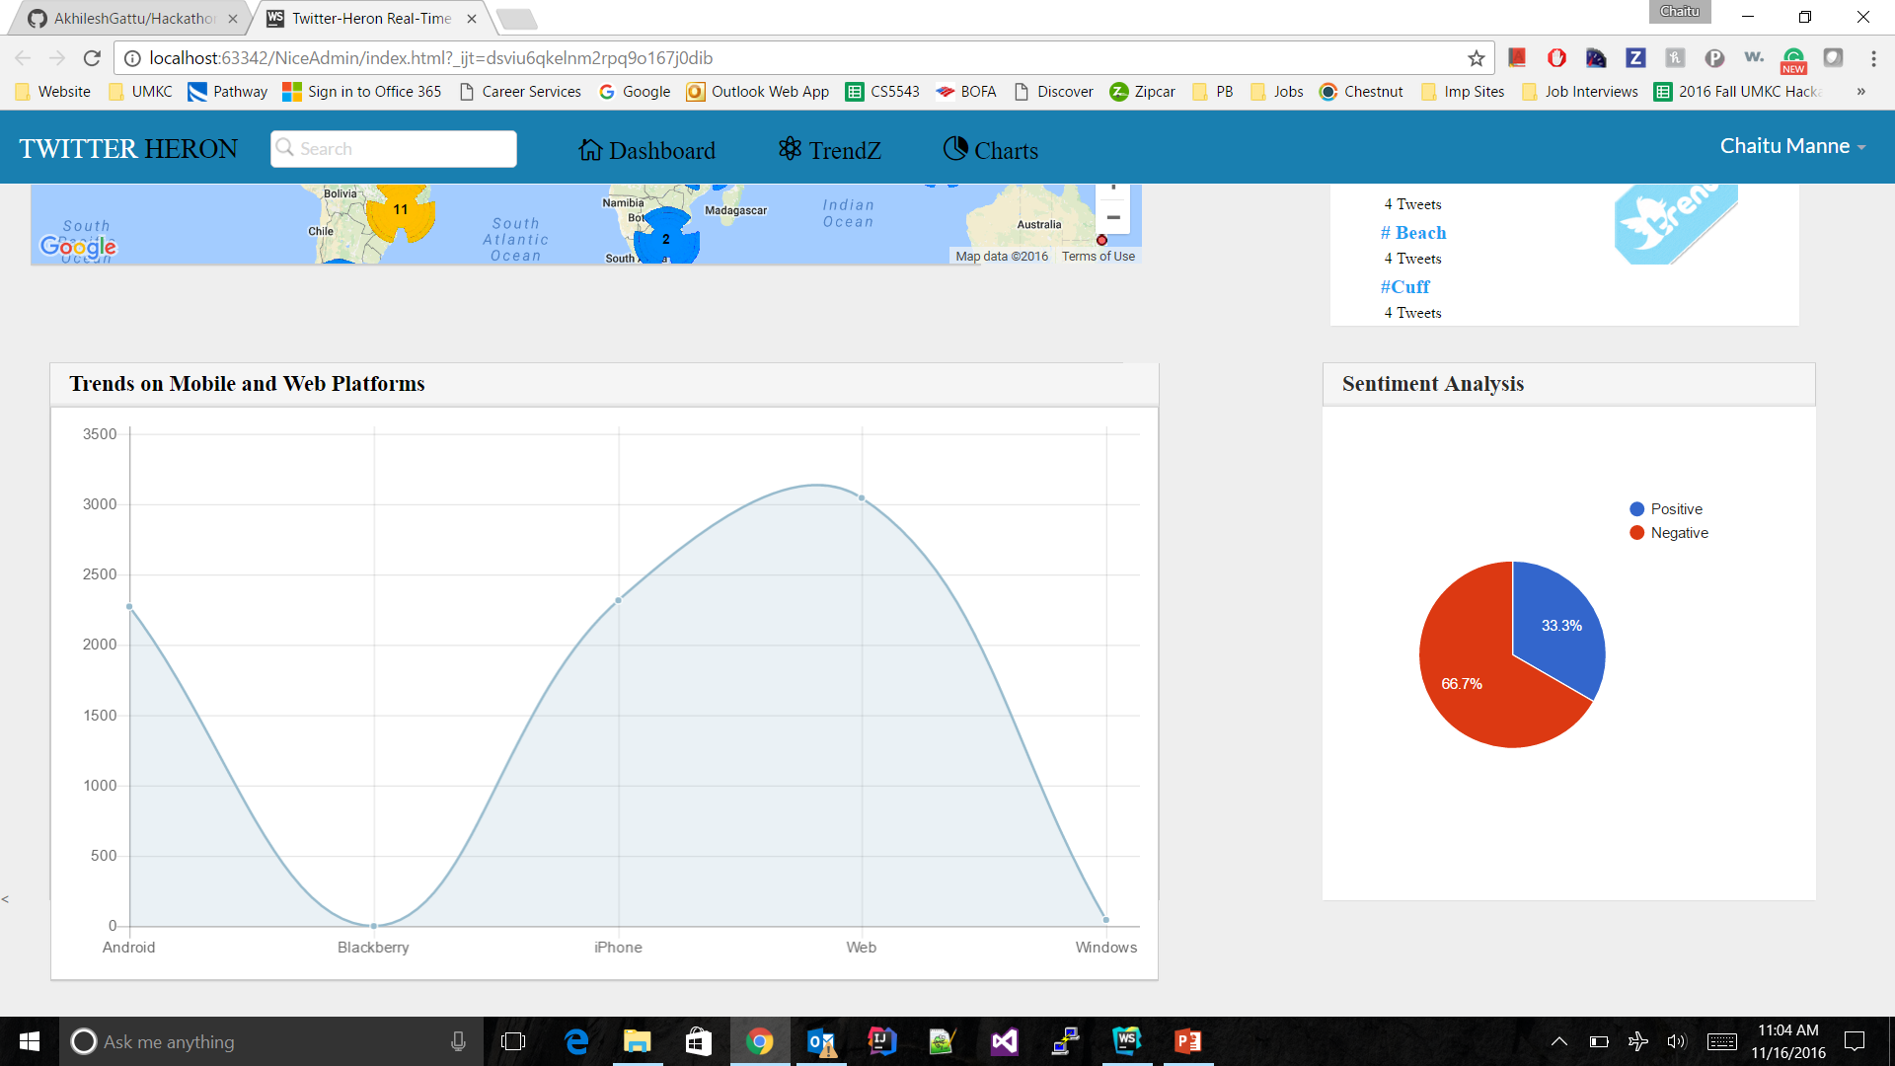
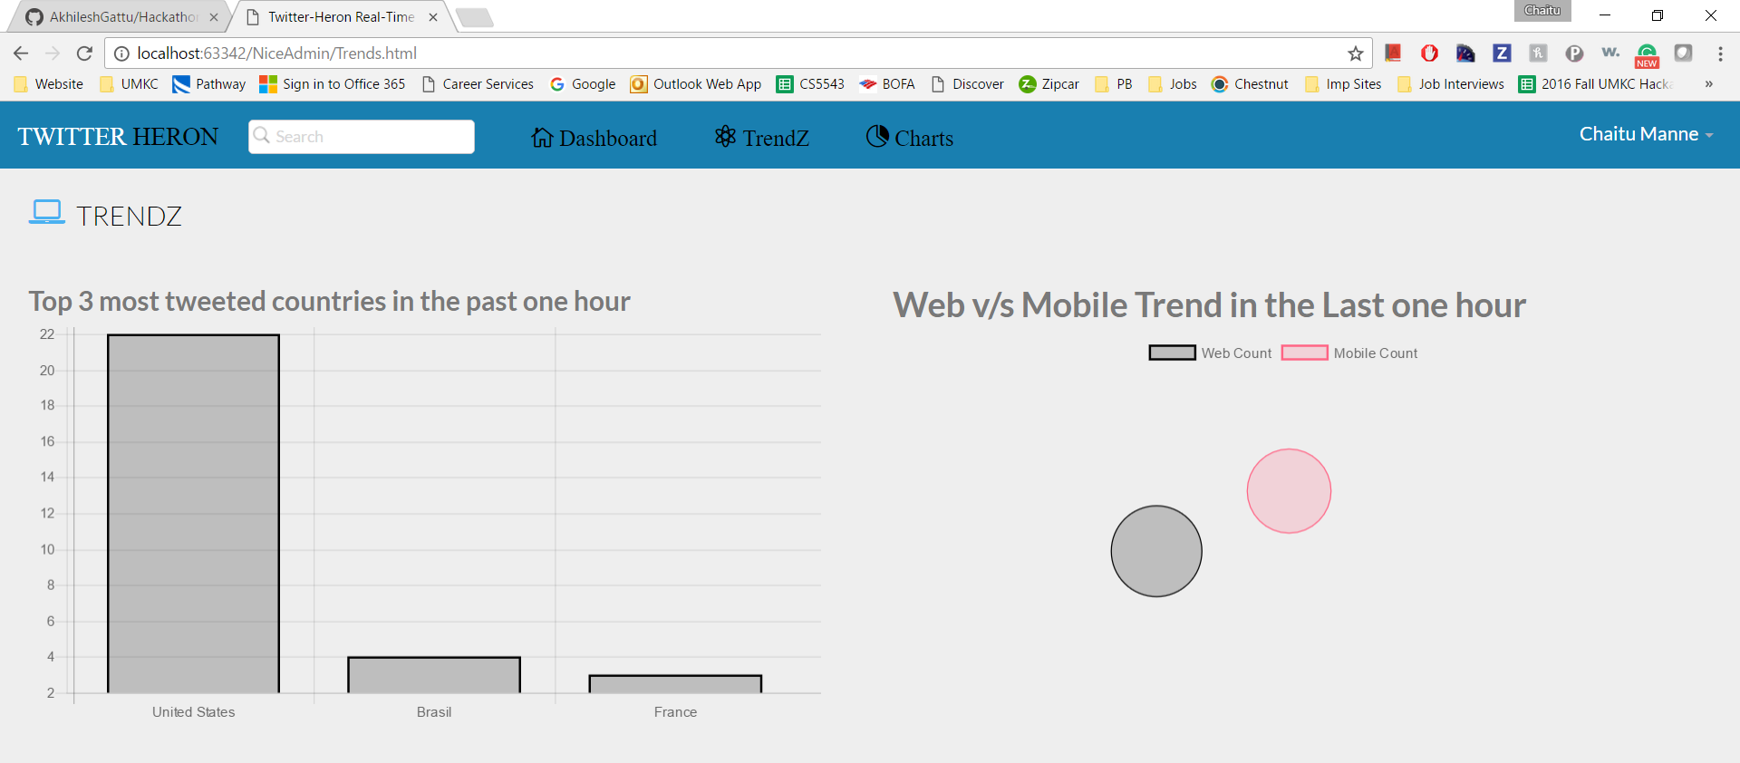
Output

